Slide 1
01011010 00110101 11001010 01011101 00101101 10101100 01011010
10100101 01101011 00011010 10110101 01011010 11010101 00101101
1
0
0
0
0
1
0
1
DIGITAL LOGIC DESIGN
Design and Simulation of
8-Bit Signed Binary Number Representation
Using the Sign-Magnitude Method
BY TEAM MEMBERS:
2620030230_Ramya Sree
2620030178_Manvitha
2620030188_Bhargav Karthik
2620030194_Shiva Sai
11010010 01011010 00110101 11001010 01011101 00101101 10101100
01011010 10100101 01101011 00011010 10110101 01011010 11010101
A study of representing and simulating positive & negative integers
within an 8-bit binary word

Slide 2
Introduction & Objective
Digital systems store everything — including negative numbers — as bits. Since plain binary only expresses magnitude, a dedicated scheme is needed to also encode the sign of a value. The Sign-Magnitude method is the most intuitive of these schemes, closely mirroring how humans write signed numbers on paper (a ‘+’ or ‘–’ followed by the value).
AN 8-BIT WORD
1
0
1
0
1
1
0
1
Sign
2^6
2^5
2^4
2^3
2^2
2^1
2^0
1
Represent
Encode both positive and negative integers within a fixed 8-bit word.
MSB = Sign Bit
Remaining 7 Bits
0 = Positive 1 = Negative
Represent the Magnitude
2
Design
Define the sign-magnitude bit structure and its encoding/decoding rules.
“One bit for sign, the rest for value —
closes the gap between binary and
everyday signed notation.”
3
Simulate
Model the scheme in software/logic to verify range, zero cases and arithmetic.
8-BIT SIGN-MAGNITUDE REPRESENTATION
02

Slide 3
Ways to Represent Signed Numbers
Three common binary schemes — this project focuses on the first
FOCUS OF THIS DECK
Sign-Magnitude
1’s Complement
2’s Complement
MSB stores the sign (0/1); remaining bits store the magnitude, unchanged from unsigned binary.
Negative numbers formed by inverting every bit of the positive value.
Negative numbers formed by inverting all bits, then adding 1. Used in most real hardware.
-5 → 1 0000101
-5 → 1 1111010
-5 → 1 1111011
8-BIT SIGN-MAGNITUDE REPRESENTATION
03

Slide 4
Structure of the Sign-Magnitude Format
S
M
M
M
M
M
M
M
SIGN
2^6
2^5
2^4
2^3
2^2
2^1
2^0
Bit 7
Bits 6 – 0
(Sign
Bit)
7-bit Magnitude Field — same value as ordinary unsigned binary
0
1
Sign Bit = 1
Sign Bit = 0
The value is positive.
Example: 0 0000101 = +5
The value is negative.
Example: 1 0000101 = –5
General form: N = (–1)^SIGN × |Magnitude|, where the sign bit selects the exponent of –1
8-BIT SIGN-MAGNITUDE REPRESENTATION
04

Slide 5
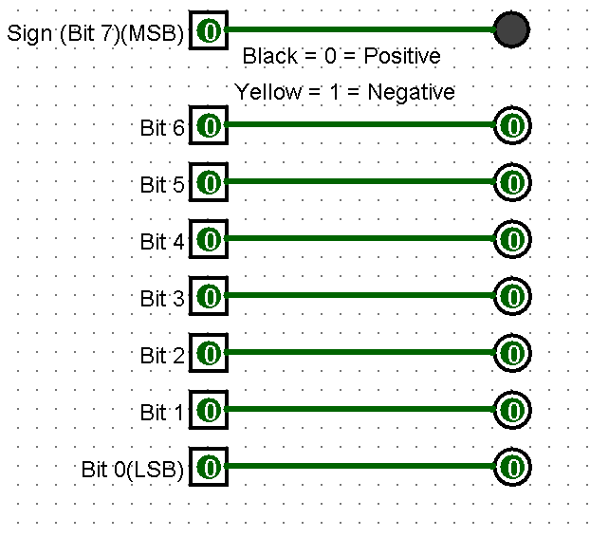
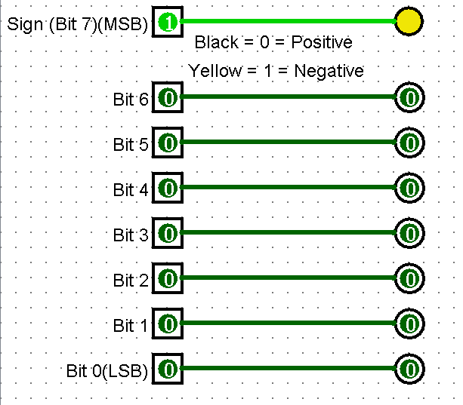

Slide 6
Encoding Examples
Decimal values converted into 8-bit sign-magnitude form
Decimal | Sign | Magnitude (7 bits) | 8-bit Sign-Magnitude | Note
+5 | 0 | 0000101 | 0 0000101 | positive
–5 | 1 | 0000101 | 1 0000101 | negative
+127 | 0 | 1111111 | 0 1111111 | max positive
–127 | 1 | 1111111 | 1 1111111 | max negative
+0 | 0 | 0000000 | 0 0000000 | zero (positive)
–0 | 1 | 0000000 | 1 0000000 | zero (negative)
Notice: +0 and –0 have two different bit patterns for the same value — a key quirk of this method (see next slide).
8-BIT SIGN-MAGNITUDE REPRESENTATION
05

Slide 7
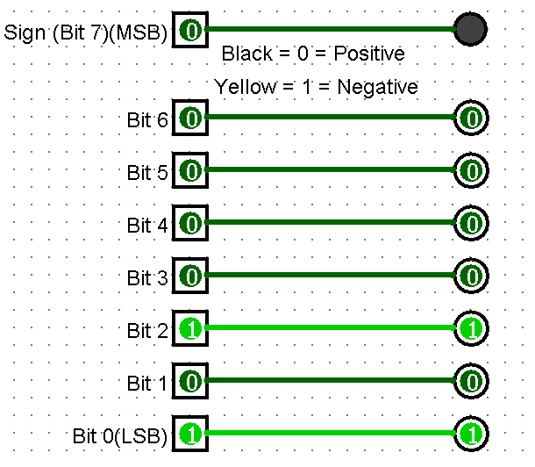
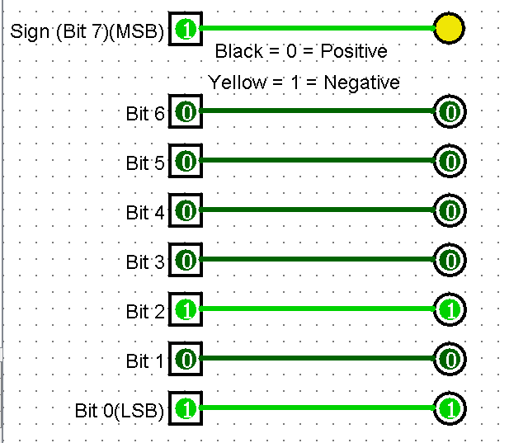
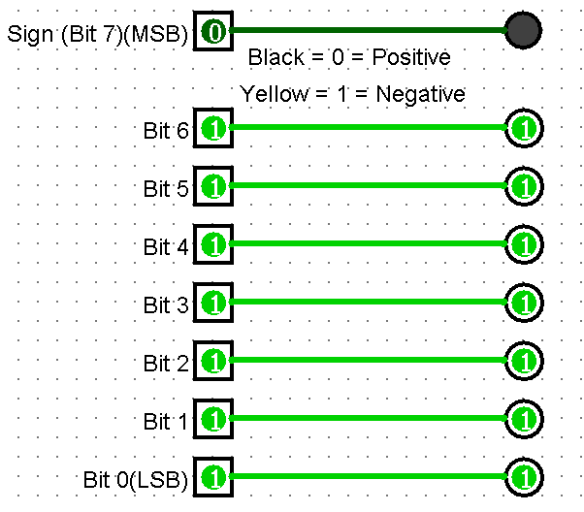
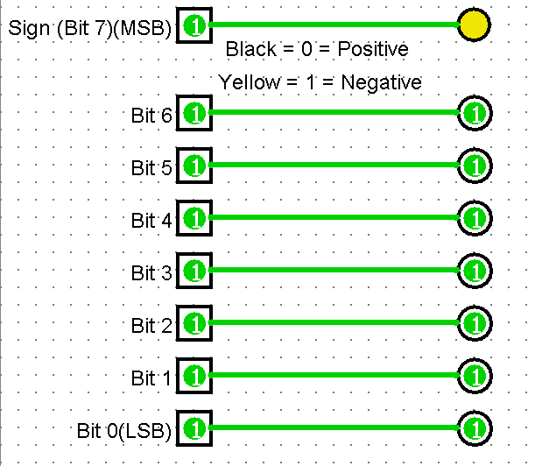
+5
-5
+127
-127

Slide 8
Range and Special Cases
What 8 bits can and cannot cleanly express
7
–127 to +127
256
magnitude bits
available for value
representable
decimal range
total bit patterns,
only 255 distinct values
The Duplicate-Zero Problem
Symmetric Range
0
0
0
0
0
0
0
0
= +0
1
0
0
0
0
0
0
0
= –0
–127
0 / –0
+127
Two encodings map to the same value, wasting a bit pattern and
complicating equality checks in simulation.
Unlike 2’s complement (–128 to +127), sign-magnitude is
perfectly symmetric — at the cost of the duplicate zero above.
8-BIT SIGN-MAGNITUDE REPRESENTATION
06

Slide 9
Simulating Sign-Magnitude Arithmetic
Unlike 2’s complement, sign-magnitude cannot simply add bit patterns — the simulation logic must branch on the operand signs before performing magnitude arithmetic.
1
2
3
4
5
Read Signs
Compare Signs
Subtract if Differ
Assign Result Sign
Check Overflow
→
→
→
→
Extract the MSB of both operands to identify each number’s sign.
If signs match, add the magnitudes and keep the common sign.
If signs differ, subtract the smaller magnitude from the larger.
Result takes the sign of the operand with the larger magnitude.
Flag overflow if the magnitude result exceeds 7-bit capacity (127).
WORKED EXAMPLE
(+5) + (–3): signs differ → subtract magnitudes 5 – 3 = 2 → sign of larger magnitude (+5) is positive → result = +2
0 0000101 + 1 0000011 → 0 0000010
8-BIT SIGN-MAGNITUDE REPRESENTATION
07

Slide 10
Advantages, Limitations & Conclusion
Advantages
Limitations
✓
Simple, intuitive mapping to sign + value notation
✗
Two representations of zero (+0 and –0)
✓
Symmetric range: equal count of positive & negative values
✗
Addition/subtraction needs conditional sign logic, not direct bit addition
✓
Easy manual conversion between decimal and binary
✗
Hardware adders are more complex than 2’s complement designs
✓
Sign bit is trivially isolated by reading the MSB
✗
Rarely used in real processors — mainly educational value
Conclusion
The sign-magnitude method offers a clear, human-readable foundation for understanding signed binary representation. Simulation confirms its correct range (–127 to +127) and highlights the practical issues — duplicate zero and added arithmetic complexity — that led modern hardware to adopt 2’s complement instead.
8-BIT SIGN-MAGNITUDE REPRESENTATION
08

Slide 11
Thank
you!

